Slide 1
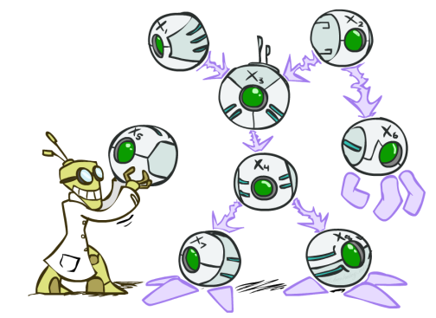
Bayes’ Nets
http://ai.berkeley.edu.]
Notes:
Please retain proper attribution, including the reference to ai.berkeley.edu. Thanks!

Slide 2
Office Hr Recap: HMM and Viterbi
Fish sleep.
HMM helps to compute
Pr(Fish sleep) or Pr(sleep follows fish) → language model, autocomplete
Pr(noun+verb) vs Pr(verb+noun) ➔ part-of-speech tagging (Viterbi)

Slide 3
Part-of-speech tagging with Hidden Markov Models
tags
words
output probability
transition probability

Slide 4
A Simple POS HMM
0.2
0.1
0.8
start
0.8
noun
verb
0.7
end
0.2
0.1
0.1

Slide 5
Word Emission Probabilities P ( word | state )
A two-word language: “fish” and “sleep”
Suppose in our training corpus,
“fish” appears 8 times as a noun and 5 times as a verb
“sleep” appears twice as a noun and 5 times as a verb
Emission probabilities:
Noun
P(fish | noun) : 0.8
P(sleep | noun) : 0.2
Verb
P(fish | verb) : 0.5
P(sleep | verb) : 0.5

Slide 6
Viterbi Probabilities

Slide 7
0.2
0.1
0.8
0.8
0.7
end
start
noun
verb
0.2
0.1
0.1

Slide 8
Dynamic Programming : best length-k prefix
0.2
0.1
0.8
0.8
0.7
end
start
noun
verb
0.2
Token 1: fish
0.1
0.1

Slide 9
0.2
0.1
0.8
0.8
0.7
end
start
noun
verb
0.2
0.1
0.1
Token 1: fish

Slide 10
0.2
0.1
0.8
0.8
0.7
end
start
noun
verb
0.2
0.1
0.1
Token 2: sleep
(if ‘fish’ is verb)

Slide 11
0.2
0.1
0.8
0.8
0.7
end
start
noun
verb
0.2
0.1
0.1
Token 2: sleep
(if ‘fish’ is verb)

Slide 12
0.2
0.1
0.8
0.8
0.7
end
start
noun
verb
0.2
0.1
0.1
Token 2: sleep
(if ‘fish’ is a noun)

Slide 13
0.2
0.1
0.8
0.8
0.7
end
start
noun
verb
0.2
0.1
0.1
Token 2: sleep
(if ‘fish’ is a noun)

Slide 14
0.2
0.1
0.8
0.8
0.7
end
start
noun
verb
0.2
0.1
0.1
Token 2: sleep take maximum, set back pointers

Slide 15
0.2
0.1
0.8
0.8
0.7
end
start
noun
verb
0.2
0.1
0.1
Token 2: sleep take maximum, set back pointers

Slide 16
0.2
0.1
0.8
0.8
0.7
end
start
noun
verb
0.2
0.1
0.1
Token 3: end

Slide 17
0.2
0.1
0.8
0.8
0.7
end
start
noun
verb
0.2
0.1
0.1
Token 3: end take maximum, set back pointers

Slide 18
0.2
0.1
0.8
0.8
0.7
end
start
noun
verb
0.2
0.1
0.1
Decode: fish = noun sleep = verb

Slide 19
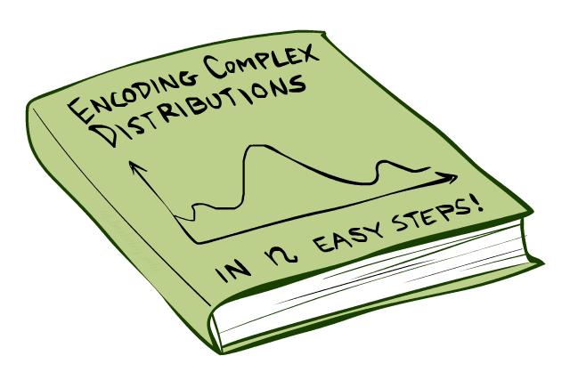
Bayes’Nets: Big Picture

Slide 20


Bayes’ Nets: Big Picture
Two problems with using full joint distribution tables as our probabilistic models:
Unless there are only a few variables, the joint is WAY too big to represent explicitly
Hard to learn (estimate) anything empirically about more than a few variables at a time
Bayes’ nets: a technique for describing complex joint distributions (models) using simple, local distributions (conditional probabilities)
More properly called graphical models
MM, HMM, etc. is an instance

Slide 21
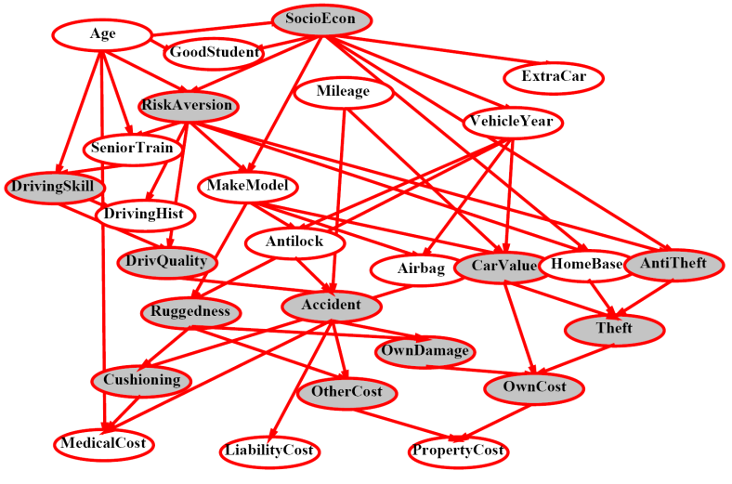
Example Bayes’ Net: Insurance

Slide 22
Example Bayes’ Net: Car

Slide 23
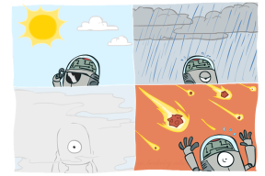
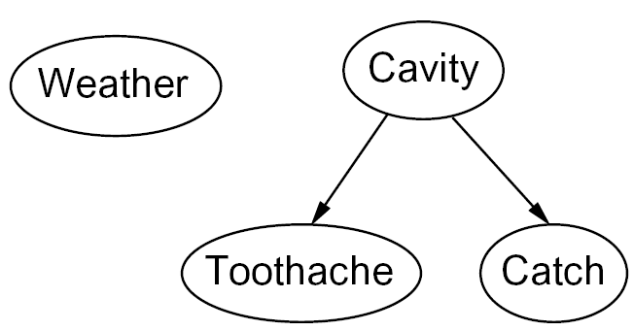
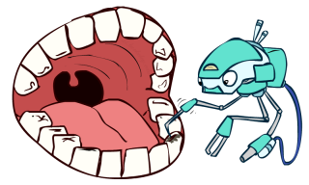
Graphical Model Notation
Nodes: variables (with domains)
Can be assigned (observed) or unassigned (unobserved)
Arcs: interactions
Indicate “direct influence” between variables
For now: imagine that arrows mean direct causation (in general, they don’t!)

Slide 24
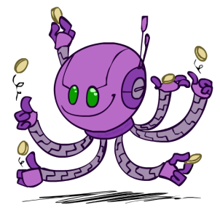
Example: Coin Flips
N independent coin flips
No interactions between variables: absolute independence
X₁
X₂
X_{n}

Slide 25
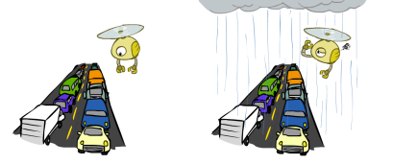
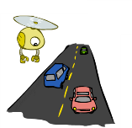
Example: Traffic
Variables:
R: It rains
T: There is traffic
Model 1: independence
Why is an agent using model 2 better?
Model 2: rain causes traffic
R
R
T
T

Slide 26
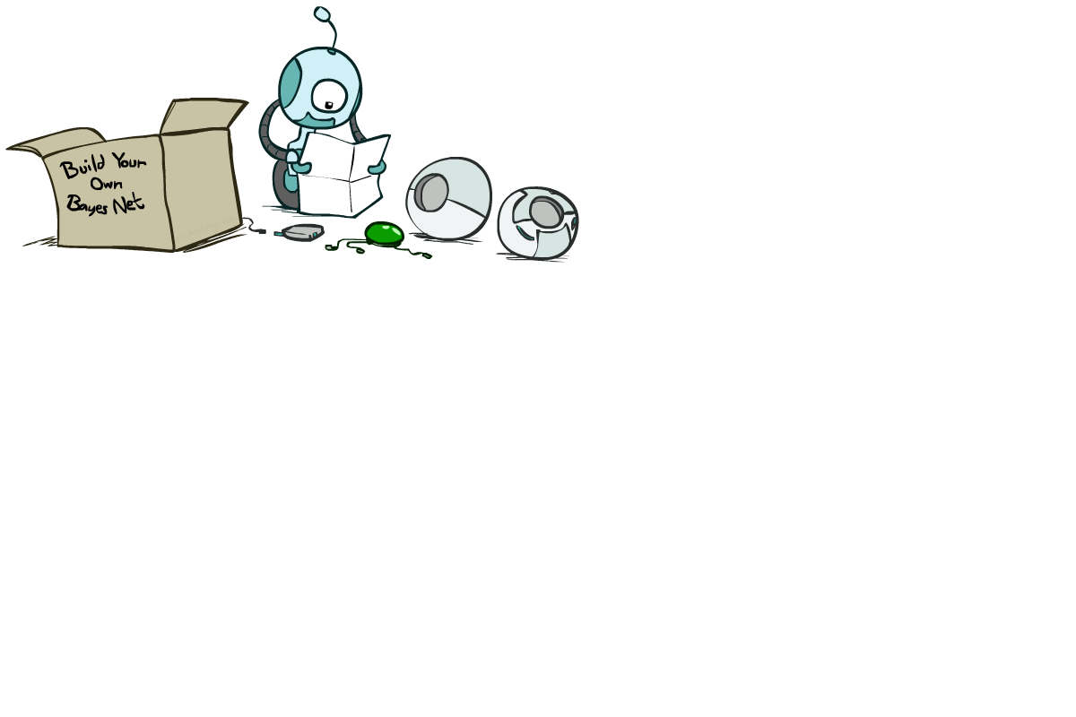
Bayes’ Net Semantics

Slide 27
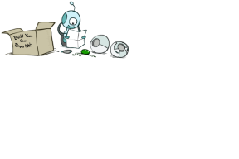


Probabilities in BNs
Bayes’ nets implicitly encode joint distributions
As a product of local conditional distributions
To see what probability a BN gives to a full assignment, multiply all the relevant conditionals together:
Example:

Slide 28


Probabilities in BNs
Why are we guaranteed that setting
results in a proper joint distribution?
Chain rule (valid for all distributions):
Assume conditional independences:
→ Consequence:

Slide 29

Example: Coin Flips
X₁
X₂
X_{n}
h | 0.5
t | 0.5
h | 0.5
t | 0.5
h | 0.5
t | 0.5
Only distributions whose variables are absolutely independent can be represented by a Bayes’ net with no arcs.
Notes:
demo

Slide 30


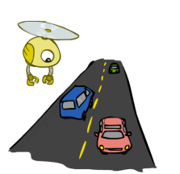
Example: Traffic
R
+r | 1/4
-r | 3/4
+r | +t | 3/4
 | -t | 1/4
T
-r | +t | 1/2
 | -t | 1/2
Notes:
demo

Slide 31
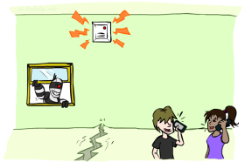
Example: Alarm Network
B | P(B)
+b | 0.001
-b | 0.999
E | P(E)
+e | 0.002
-e | 0.998
Burglary
Earthqk
Alarm
B | E | A | P(A|B,E)
+b | +e | +a | 0.95
+b | +e | -a | 0.05
+b | -e | +a | 0.94
+b | -e | -a | 0.06
-b | +e | +a | 0.29
-b | +e | -a | 0.71
-b | -e | +a | 0.001
-b | -e | -a | 0.999
John calls
Mary calls
A | J | P(J|A)
+a | +j | 0.9
+a | -j | 0.1
-a | +j | 0.05
-a | -j | 0.95
A | M | P(M|A)
+a | +m | 0.7
+a | -m | 0.3
-a | +m | 0.01
-a | -m | 0.99
Notes:
demo

Slide 32
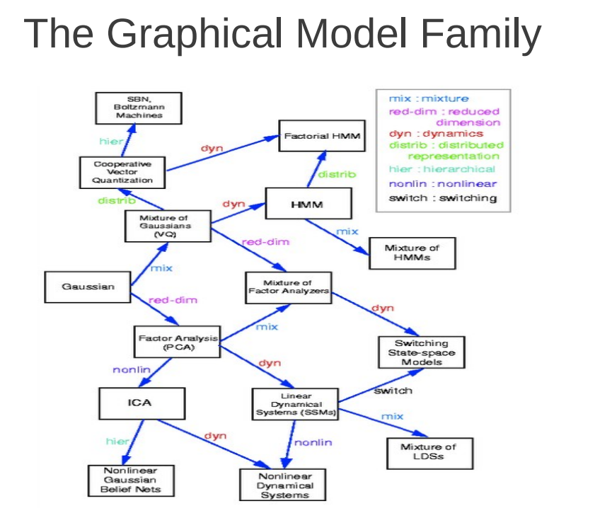

Slide 33
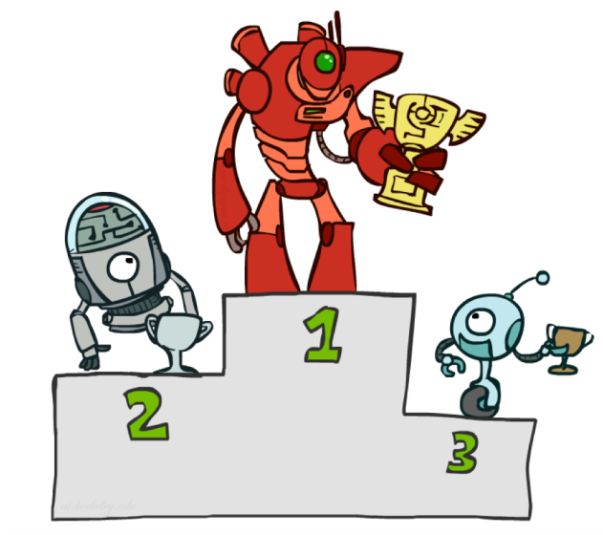
Contest Highlights (~top 10%)

Slide 34
Data Preparation
Stemming, .lower(), .get_repla()
love/loved, LOVE/Love, email/E-mail
Nltk.stopwords.words(“english”)

Slide 35





Regression Tree (CART)
regression tree (also known as classification and regression
tree):
Decision rules same as in decision tree
Contains one score in each leaf value
Input: age, gender, occupation, …
Does the person like computer games
age < 15
Y
N
is male?
Y
N
prediction score in each leaf
+2
+0.1
-1

Slide 36
Regression Tree Ensemble
tree1
tree2
Use Computer Daily
age < 15
Y
N
Y
N
is male?
Y
N
+2
+0.1
-1
+0.9
-0.9
f( ) = 2 + 0.9= 2.9 f( )= -1 + 0.9= -0.1
Prediction of is sum of scores predicted by each of the tree

Slide 37
Tree Ensemble methods
Very widely used, look for GBM, random forest…
Almost half of data mining competition are won by using some
variants of tree ensemble methods
Learn higher order interaction between features.
→ Build another tree that “complements” the first
https://www.youtube.com/watch?v=GM3CDQfQ4sw
Can be scalable, and are used in Industry

Slide 38
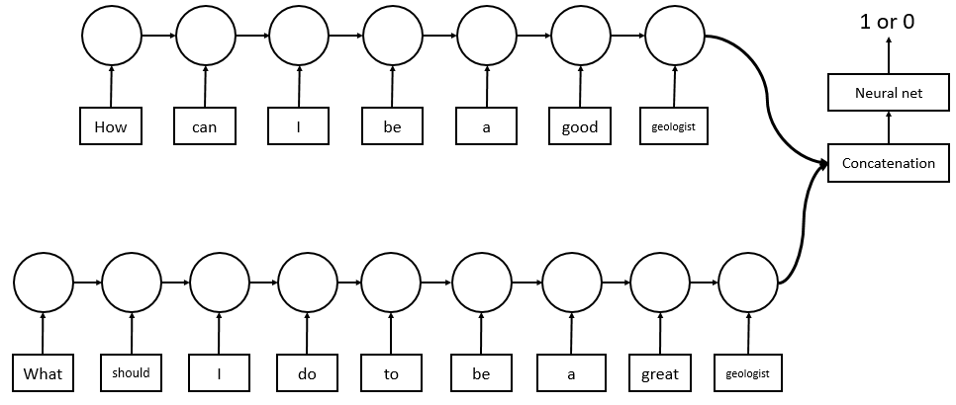
Deep Learning Approach
LSTM (RNN) is usually used for machine translation, QA, caption generation.
LSTM can encode word sequences.
-Input: word vector
-Output: question vector
Accuracy: about 84~86%
Loss: 0.24~0.26

Slide 39
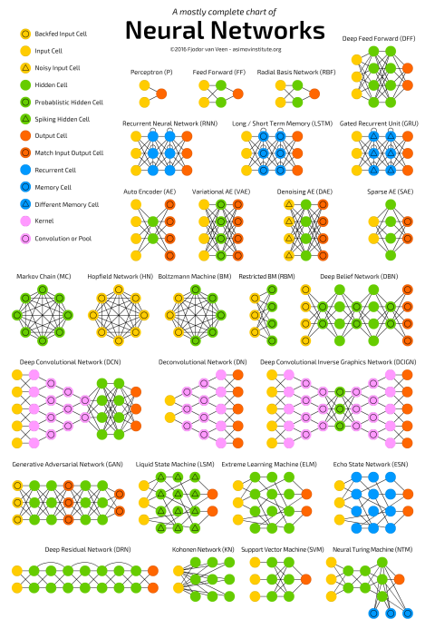
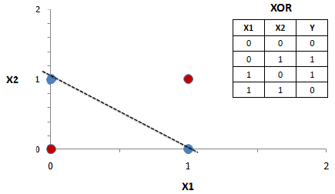
http://www.asimovinstitute.org/neural-network-zoo

Slide 40
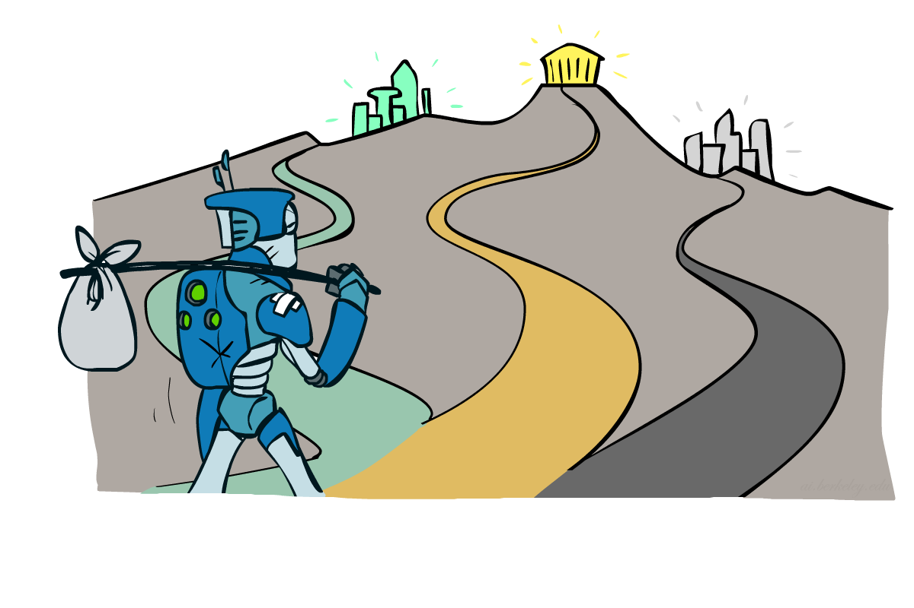
Where to Go Next?

Slide 41
Short-term advice
Train based on PPT, go back to book or http://ai.berkeley.edu videos for something unclear
Test using practice exam, but don’t overfit ☺

Slide 42
Where to go next?
Congratulations, you’ve seen the basics of modern AI
… and done some amazing work putting it to use!
How to continue:
Deep learning @Stanford https://www.youtube.com/watch?v=OQQ-W_63UgQ&list=PL3FW7Lu3i5Jsnh1rnUwq_TcylNr7EkRe6
ML@Oxford https://www.youtube.com/playlist?list=PLE6Wd9FR--EdyJ5lbFl8UuGjecvVw66F6
Reinforcement @UCL http://www0.cs.ucl.ac.uk/staff/d.silver/web/Teaching.html
Graphical model@Stanford https://www.youtube.com/playlist?list=PL50E6E80E8525B59C

Slide 43
That’s It!
Have a great summer, and always maximize your expected utilities!
Reinforcement learning teaches us to (a) DO before you know everything (and learn from doing) and (b) make many mistakes!
➔ Spirit of “아님말고” or “No→Yet” (Growth mindset)
Try to build something over the summer!

Slide 44
